Slide 1


Web Development
Week 6
Abertay
abertay.ac.uk

Slide 2
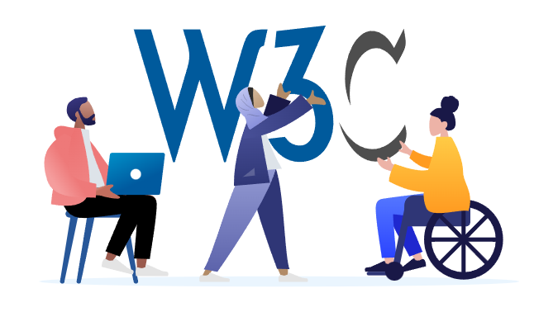
The World Wide Web Consortium
(W3C)
The W3C is an international organization who develop Web standards for:
Accessibility,
Internationalization,
Privacy,
and Security.

Slide 3
Web Content Accessibility Guidelines
(WCAG)
WCAG documents explain how to make web content accessible
W3C WCAG
GOV.uk WCAG

Slide 4
This Week
Bad Web Design
Contrast
Designing for Visual and Physical Impairments
Using Multiple Database Tables Part 1

Slide 5
Bad Websites and Inaccessibility
Abertay
abertay.ac.uk

Slide 6

Bad Websites and Inaccessibility
https://thomasdigital.com/bad-websites

Slide 7
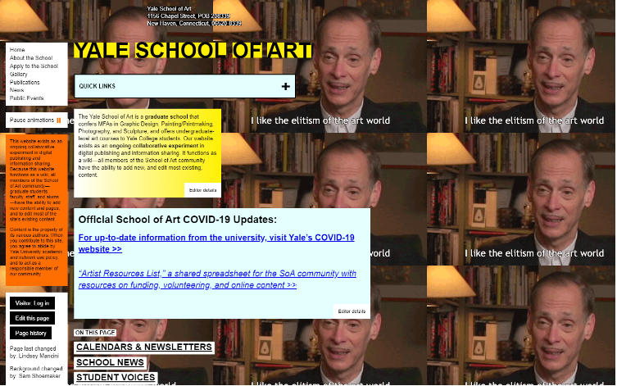
Bad Websites and Inaccessibility
Yale School of Art

Slide 8
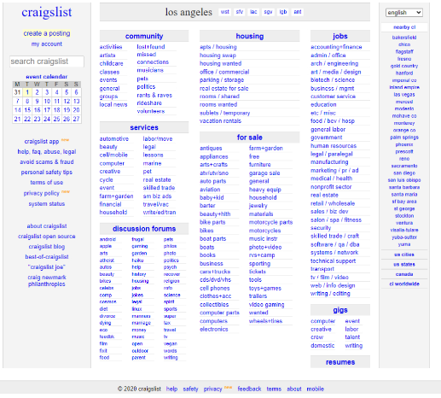
Bad Websites and Inaccessibility
Craigslist

Slide 9
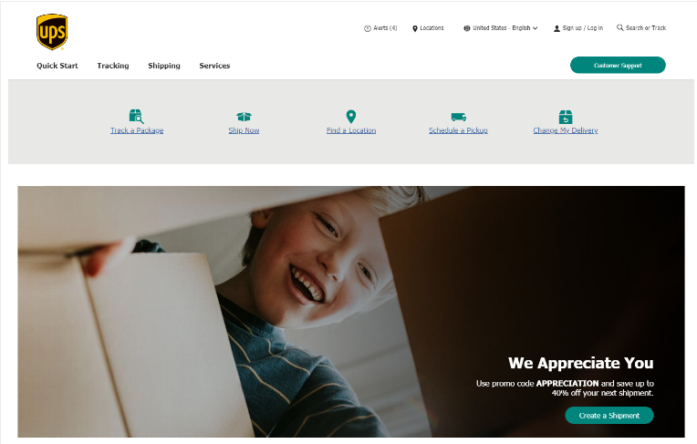
Bad Websites and Inaccessibility
UPS

Slide 10
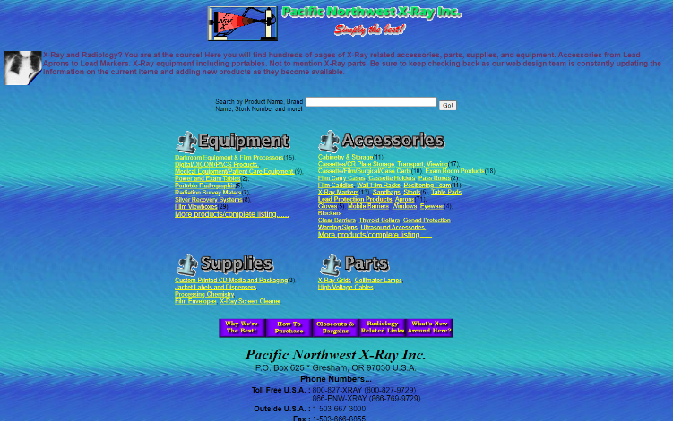
Bad Websites and Inaccessibility
Pacific Northwest X-Ray Inc

Slide 11

Bad Websites and Inaccessibility
James Bond 007 Museum

Slide 12
Contrast
Abertay
abertay.ac.uk

Slide 13
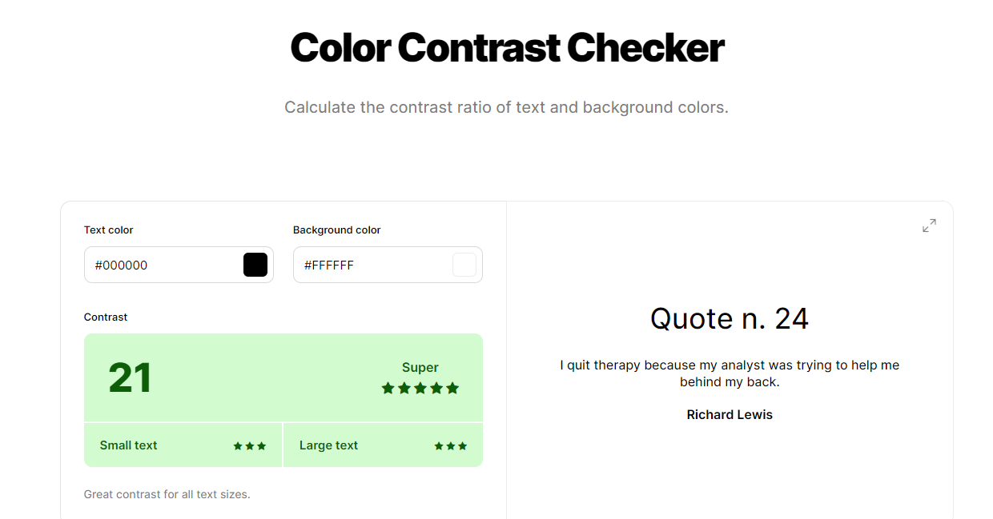
Contrast
https://coolors.co/contrast-checker/000000-ffffff

Slide 14
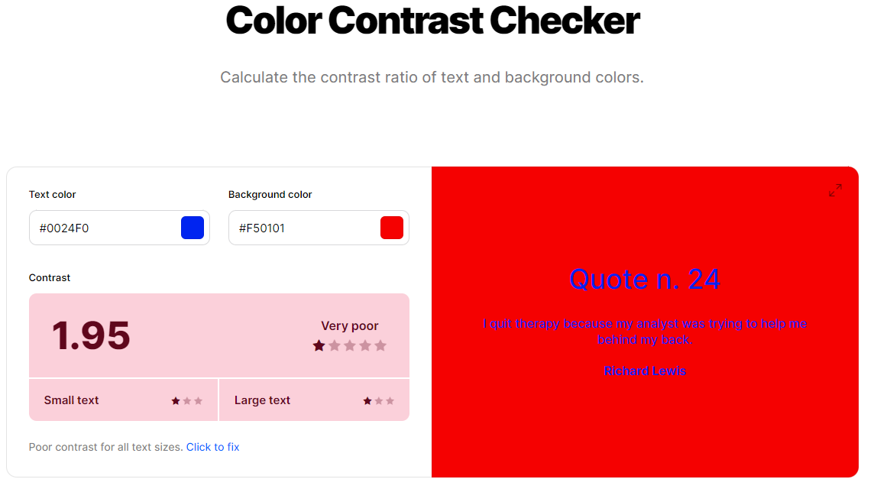
Contrast

Slide 15

Contrast
BioShock

Slide 16

Contrast
Starfield

Slide 17
Designing for Visual and Physical Impairments
Abertay
abertay.ac.uk

Slide 18
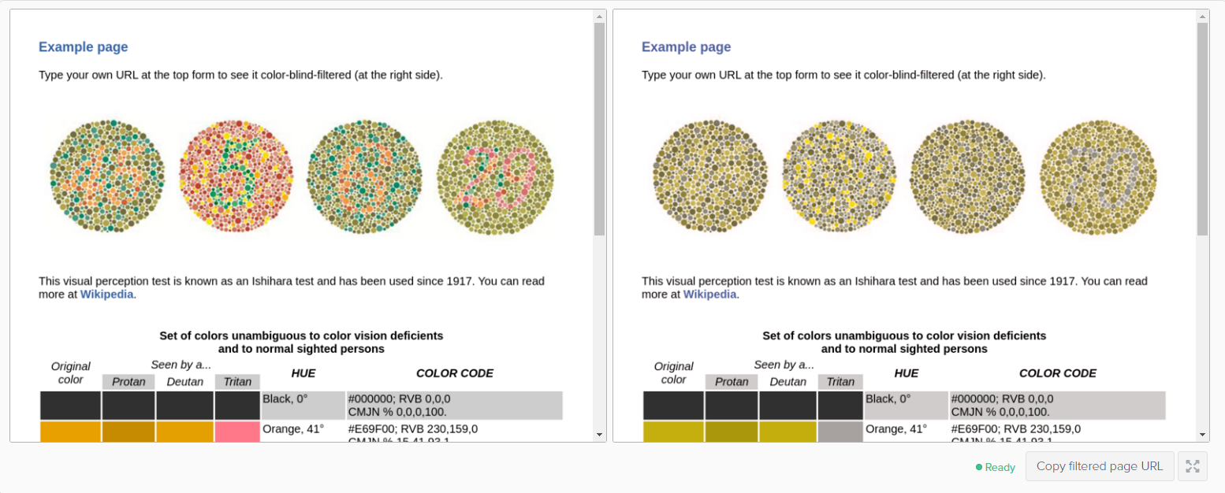
Ishihara test
Used since 1917
Colour

Slide 19
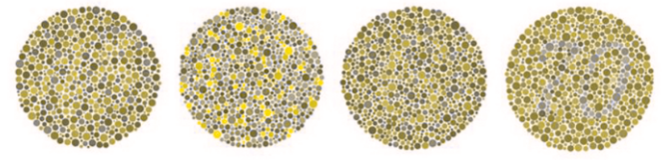
Ishihara test
Used since 1917
Colour
Protanopia

Slide 20
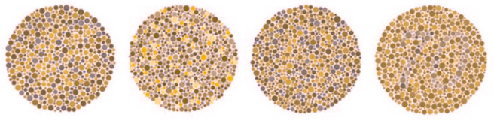
Ishihara test
Used since 1917
Colour
Protanopia
Deuteranopia

Slide 21
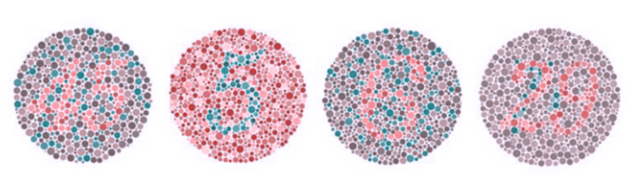
Ishihara test
Used since 1917
Colour
Protanopia
Deuteranopia
Tritanopia

Slide 22
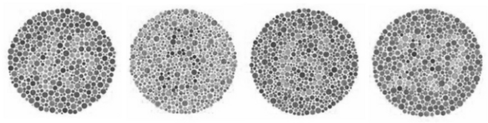
Ishihara test
Used since 1917
Colour
Protanopia
Deuteranopia
Tritanopia
Greyscale/achromatopsia

Slide 23

Colour
https://www.toptal.com/designers/colorfilter

Slide 24
Colour
https://www.toptal.com/designers/colorfilter

Slide 25
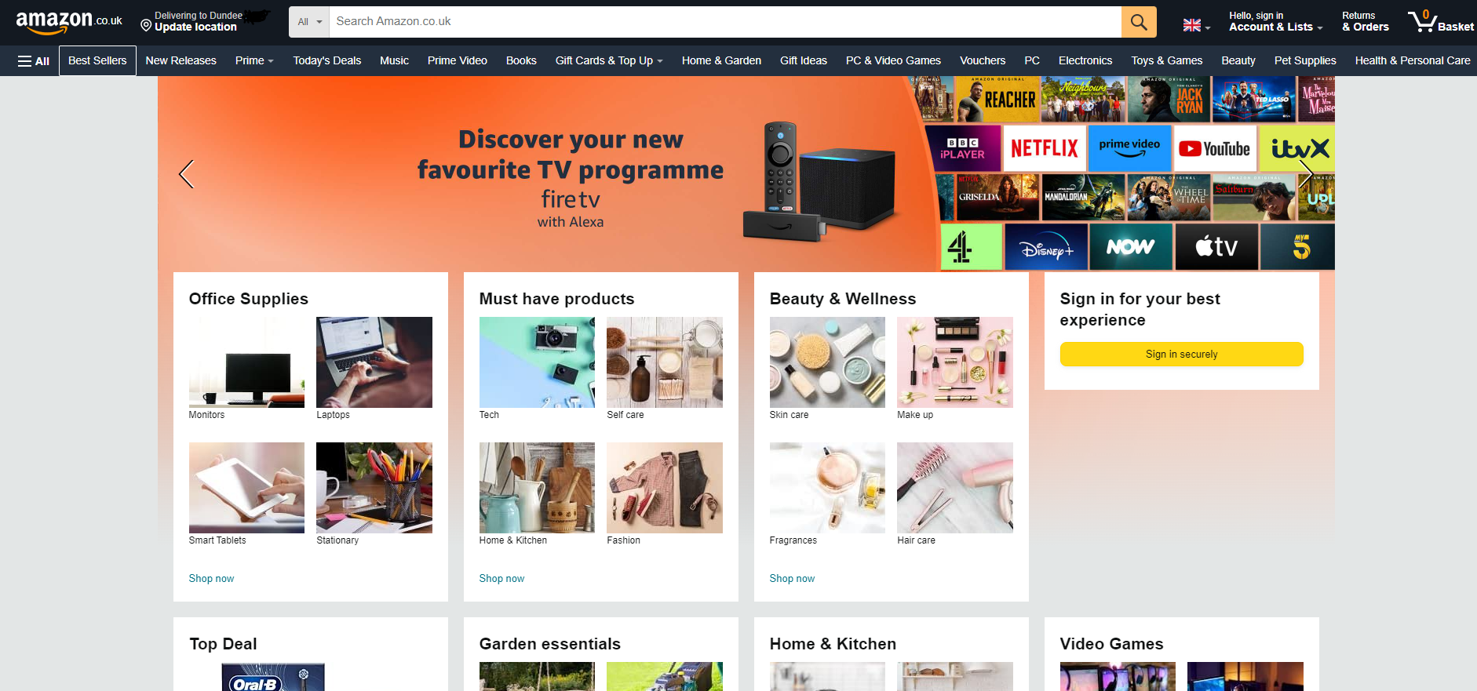
Colour
Amazon

Slide 26
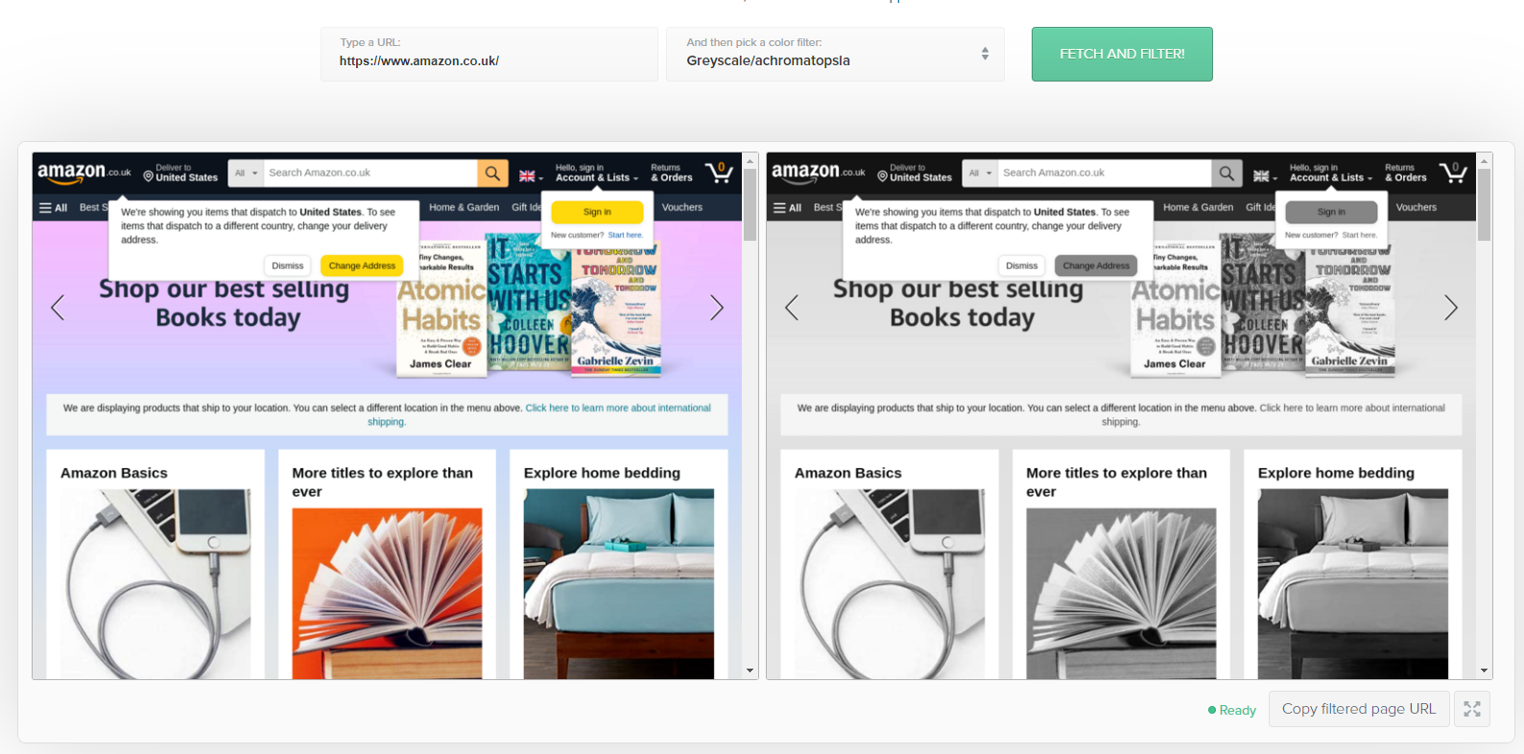
Colour
Amazon

Slide 27
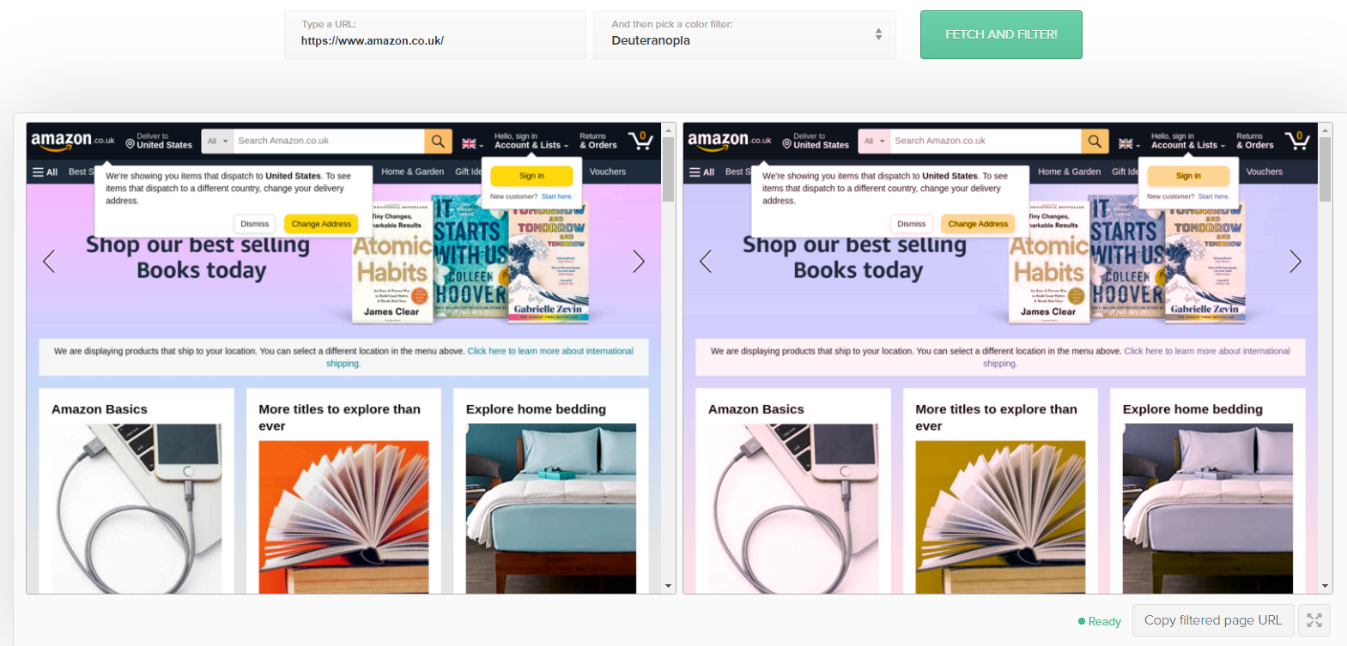
Colour
Amazon

Slide 28

Screen Readers
W3Schools Screen readers
https://blog.hubspot.com/website/screen-reader-accessibility

Slide 29
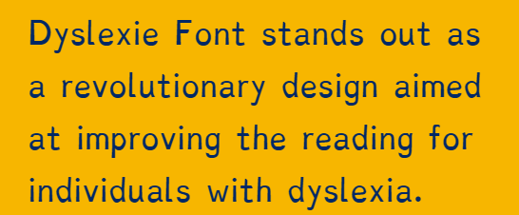
Fonts

Slide 30
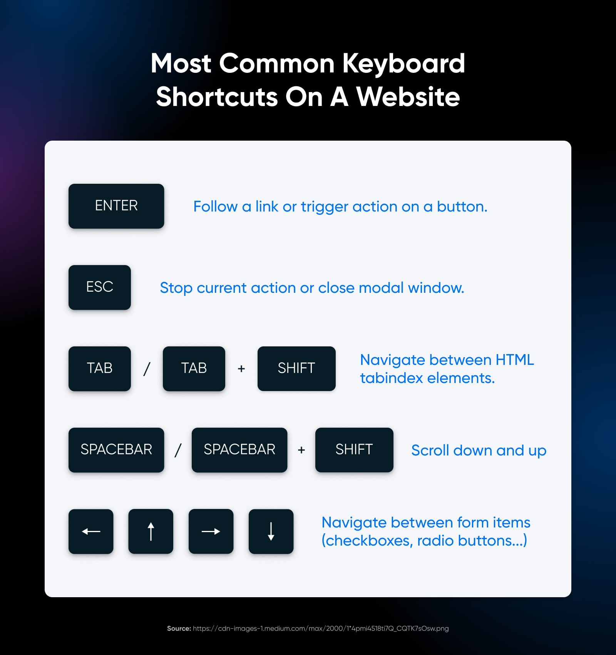
User Input
https://www.dreamhost.com/blog/make-your-website-accessible/
https://userway.org/blog/web-accessibility-for-the-mobility-impaired/

Slide 31
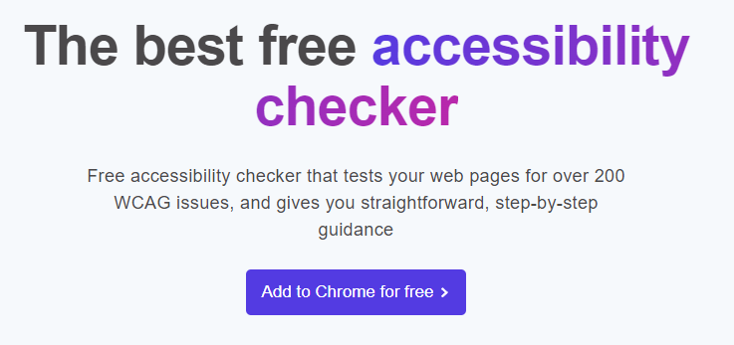
Accessibility Checkers
https://silktide.com/tools/toolbar/

Slide 32
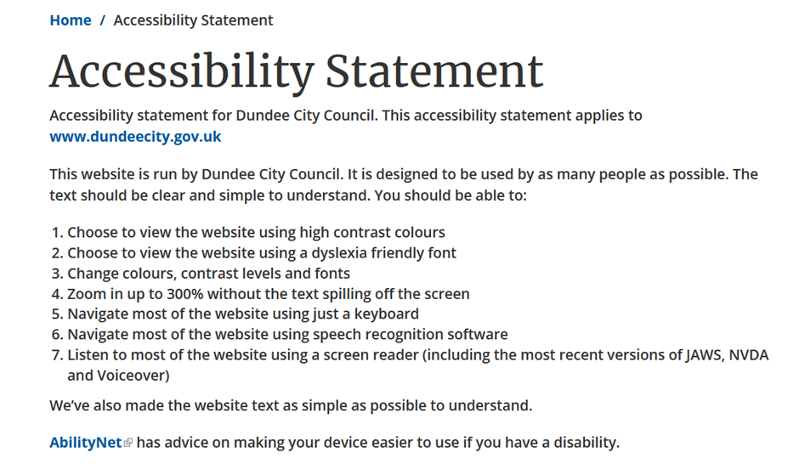
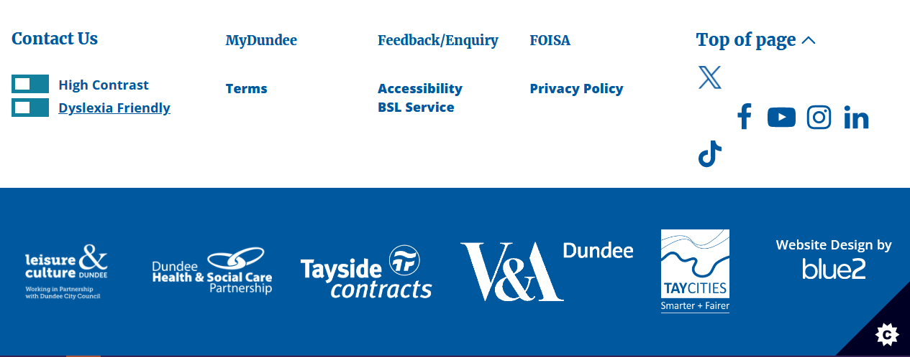
Toggling Accessibility
https://www.dundeecity.gov.uk/service-area/council-wide/accessibility-statement

Slide 33

Toggling Accessibility
https://www.w3.org/WAI/WCAG22/quickref/?versions=2.1#text-alternatives

Slide 34
Using Multiple Database Tables Part 1
Abertay
abertay.ac.uk

Slide 35
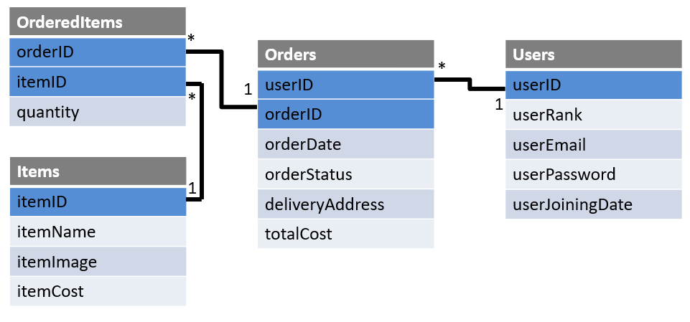
Using Multiple Database Tables

Slide 36




Using Multiple Database Tables
https://mtgcardsmith.com/

Slide 37
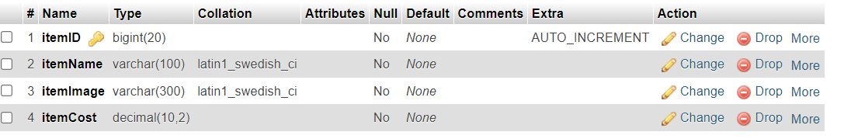
Using Multiple Database Tables

Slide 38
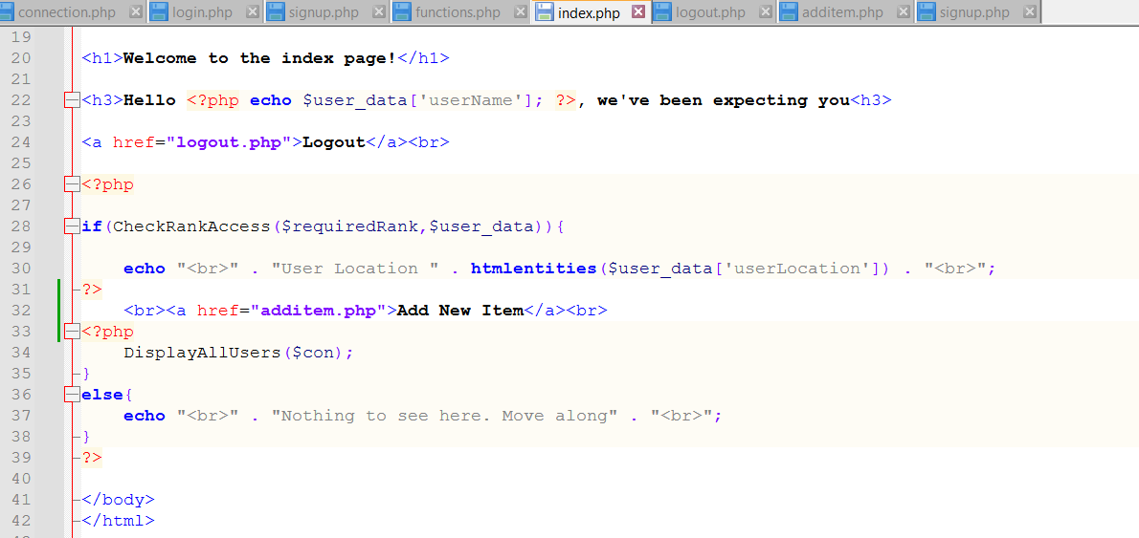
Using Multiple Database Tables

Slide 39
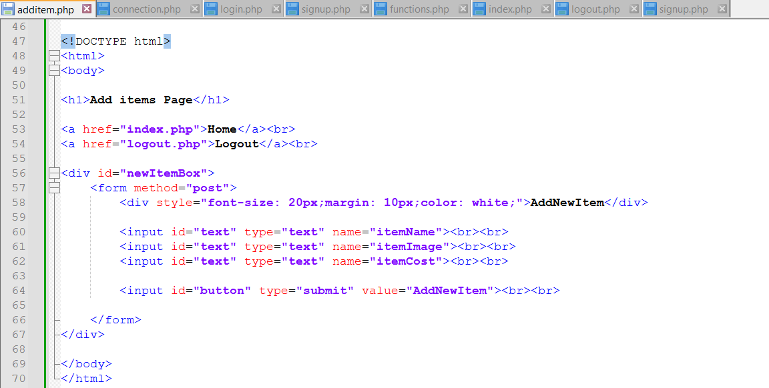
Using Multiple Database Tables

Slide 40
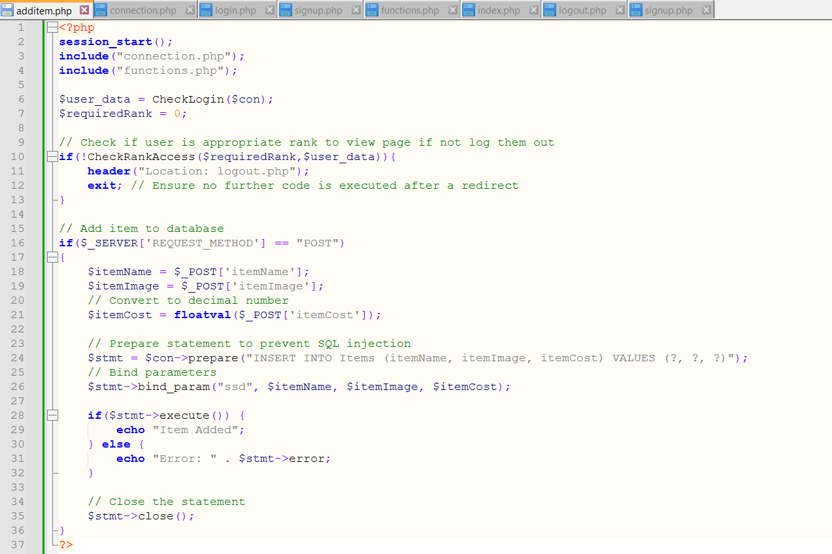
Using Multiple Database Tables

Slide 41
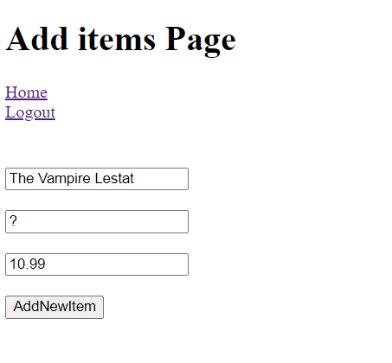
Using Multiple Database Tables

Slide 42
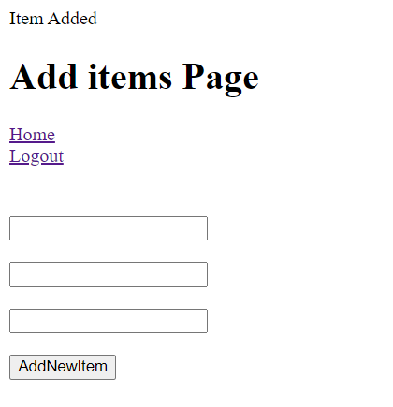
Using Multiple Database Tables

Slide 43
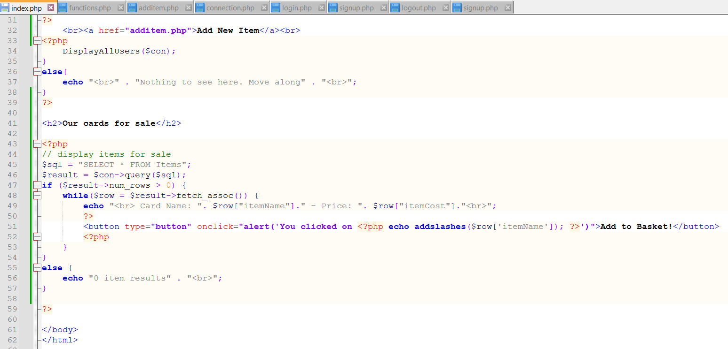
Using Multiple Database Tables

Slide 44
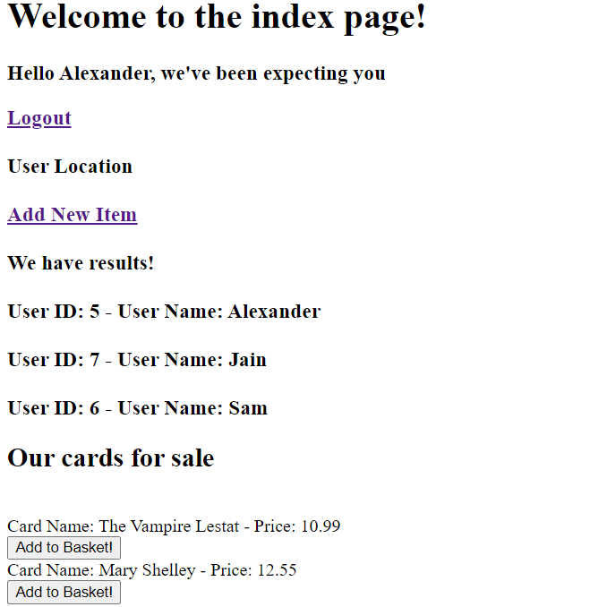
Using Multiple Database Tables

Slide 45
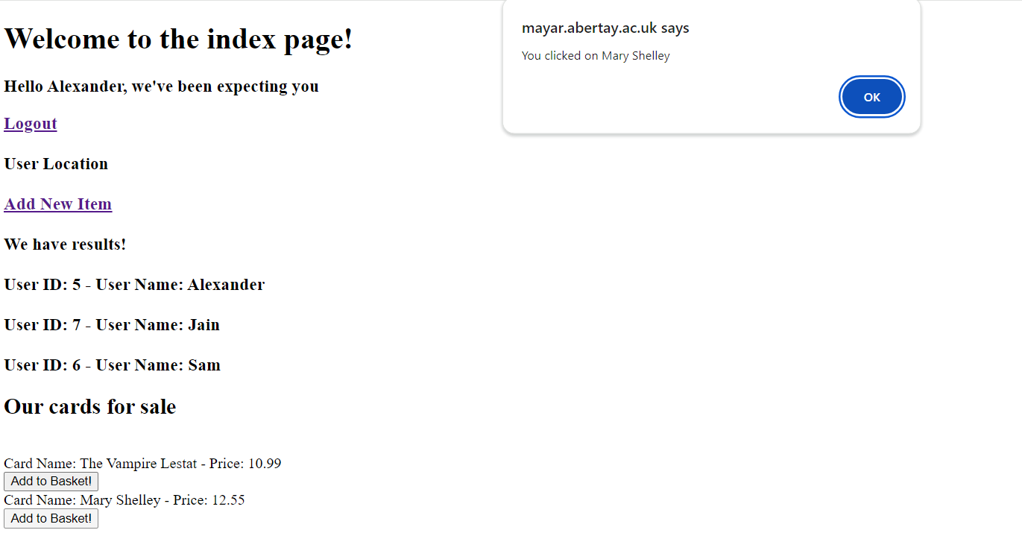
Using Multiple Database Tables

Slide 46
Next Week
Images and Video
Using Multiple Database Tables part 2
Abertay
abertay.ac.uk

